Slide 1
INTRO to DATA SCIENCE recommendation systems

Slide 2
I. Content-based filtering ii. Collaborative filtering Iii. a Simple matrix factorization model iv. The netflix prize exercise: V. recsys in python with movielens data
agenda

Slide 3
Recommendation systems
The purpose of a recommendation system is to predict a rating that a user will give an item that they have not yet rated.

Slide 4
Recommendation systems
The purpose of a recommendation system is to predict a rating that a user will give an item that they have not yet rated.
This rating is produced by analyzing other user/item ratings (and sometimes item characteristics) to provide personalized recommendations to users.

Slide 5
Recommendation systems
There are two general approaches to recsys design:

Slide 6
Recommendation systems
There are two general approaches to recsys design:
In content-based filtering, items are mapped into a feature space, and recommendations depend on item characteristics.
In contrast, the only data under consideration in collaborative filtering are user-item ratings, and recommendations depend on user preferences.

Slide 7

Recommendation systems
There are two general approaches to recsys design:
In content-based filtering, items are mapped into a feature space, and recommendations depend on item characteristics.
In contrast, the only data under consideration in collaborative filtering are user-item ratings, and recommendations depend on user preferences.
NOTE
Collaborative filtering strategies can still be item-based!

Slide 8
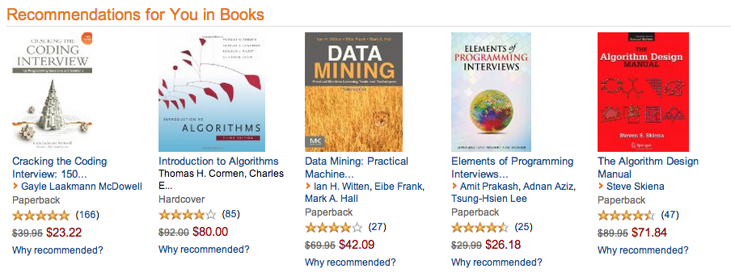
Examples – amazon
Notes:
Implicit feedback; eg browsing behavior (collaborative)

Slide 9
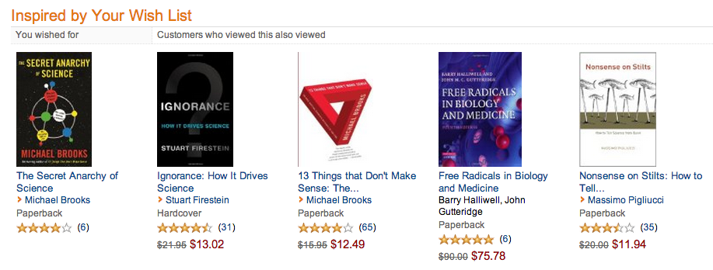
Examples – amazon
Notes:
Item-based

Slide 10
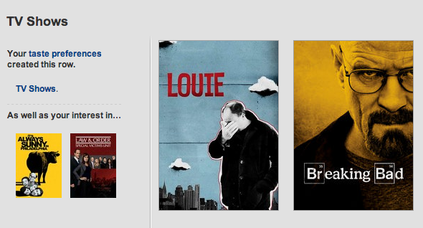
Examples – netflix
Notes:
collaborative

Slide 11
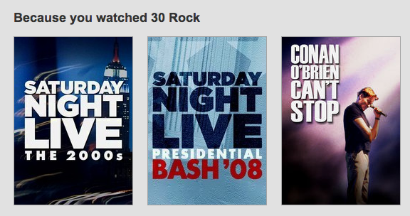
Examples – netflix
Notes:
Item-based

Slide 12
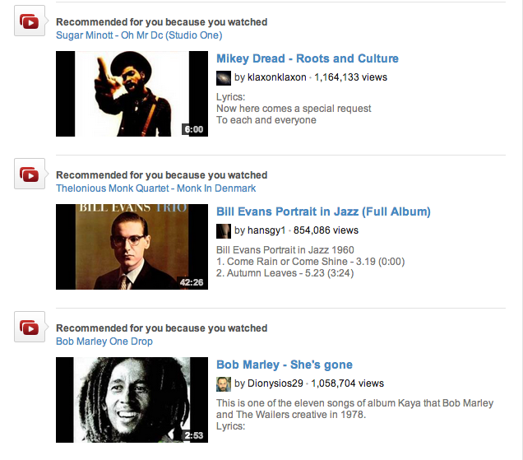
Examples – youtube
Notes:
item-based

Slide 13
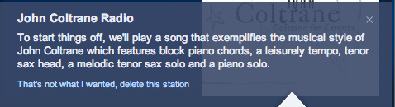
Recommendation systems
Notes:
Content-based

Slide 14
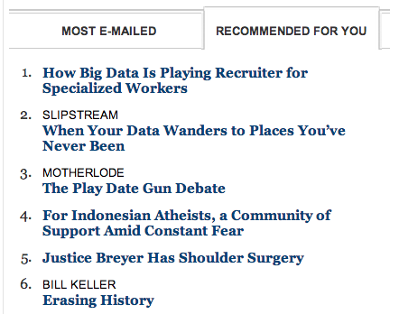
Examples – nytimes.com
Notes:
Content-based

Slide 15
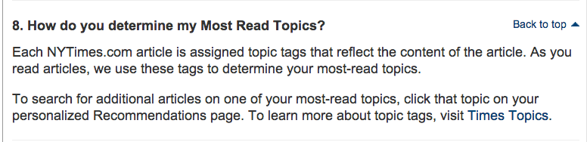
Examples – nytimes.com
Notes:
Content-based

Slide 16
I. content-based filtering
INTRO TO DATA SCIENCE

Slide 17
Content-based filtering
Content-based filtering begins by mapping each item into a feature space. Both users and items are represented by vectors in this space.

Slide 18
Content-based filtering
Content-based filtering begins by mapping each item into a feature space. Both users and items are represented by vectors in this space.
Item vectors measure the degree to which the item is described by each feature, and user vectors measure a user’s preferences for each feature.

Slide 19
Content-based filtering
Content-based filtering begins by mapping each item into a feature space. Both users and items are represented by vectors in this space.
Item vectors measure the degree to which the item is described by each feature, and user vectors measure a user’s preferences for each feature.
Ratings are generated by taking dot products of user & item vectors.

Slide 20
Content-based filtering
Content-based filtering begins by mapping each item into a feature space. Both users and items are represented by vectors in this space.
Item vectors measure the degree to which the item is described by each feature, and user vectors measure a user’s preferences for each feature.
Ratings are generated by taking dot products of user & item vectors.
NOTE
The idea is that users like items that are similar to other items they’ve consumed.

Slide 21
Example – content-based filtering
features = (big box office, aimed at kids, famous actors)
items (movies):
Finding Nemo = (5, 5, 2)
Mission Impossible = (3, -5, 5)
Jiro Dreams of Sushi = (-4, -5, -5)

Slide 22
Example – content-based filtering
features = (big box office, aimed at kids, famous actors)
items (movies):
Finding Nemo = (5, 5, 2)
Mission Impossible = (3, -5, 5)
Jiro Dreams of Sushi = (-4, -5, -5)
users:
Jason = (-3, 2, -2)

Slide 23
Example – content-based filtering
features = (big box office, aimed at kids, famous actors)
items (movies): predicted ratings*:
Finding Nemo = (5, 5, 2) (-3*5 + 2*5 -2*2) = -9
Mission Impossible = (3, -5, 5) (-3*3 - 2*5 -2*5) = -29
Jiro Dreams of Sushi = (-4, -5, -5) (3*4 - 2*5 + 2*5) = +12
users:
Jason = (-3, 2, -2)

Slide 24
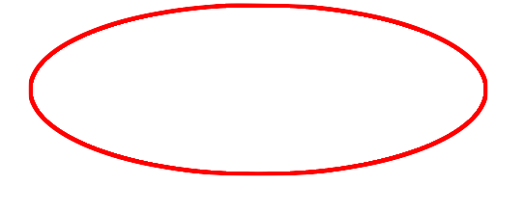
Example – content-based filtering
features = (big box office, aimed at kids, famous actors)
items (movies): predicted ratings*:
Finding Nemo = (5, 5, 2) (-3*5 + 2*5 -2*2) = -9
Mission Impossible = (3, -5, 5) (-3*3 - 2*5 -2*5) = -29
Jiro Dreams of Sushi = (-4, -5, -5) (3*4 - 2*5 + 2*5) = +12
users:
Jason = (-3, 2, -2)

Slide 25
Example – content-based filtering
features = (big box office, aimed at kids, famous actors)
items (movies): predicted ratings*:
Finding Nemo = (5, 5, 2) (-3*5 + 2*5 -2*2) = -9
Mission Impossible = (3, -5, 5) (-3*3 - 2*5 -2*5) = -29
Jiro Dreams of Sushi = (-4, -5, -5) (3*4 - 2*5 + 2*5) = +12
users:
Jason = (-3, 2, -2)
NOTE (*)
In practice, these predictions would be proportional to deviations from some global average rating (hence the negative values).

Slide 26
content-based filtering
One notable example of content-based filtering is Pandora, which maps songs into a feature space using features (or “genes”) designed by the Music Genome Project.
Using song vectors that depend on these features, Pandora can create a station with music having similar properties to a song the user selects.

Slide 27
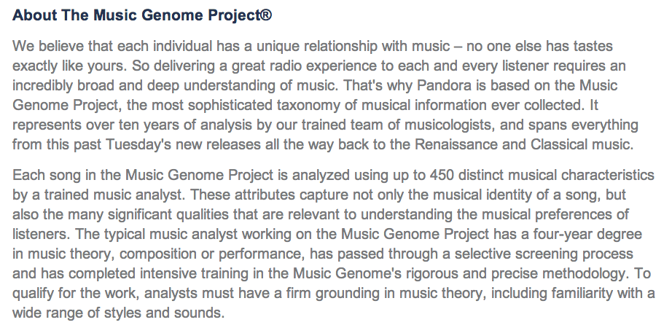
content-based filtering
source: http://www.pandora.com/about/mgp

Slide 28
content-based filtering
Content-based filtering has some difficulties:

Slide 29
content-based filtering
Content-based filtering has some difficulties:
- need to map each item into a feature space (usually by hand!)
- recommendations are limited in scope (items must be similar to each
other)
- hard to create cross-content recommendations (eg books/music
films…this would require comparing elements from different feature
spaces!)

Slide 30
II. collaborative filtering
INTRO TO DATA SCIENCE

Slide 31
Collaborative filtering
Collaborative filtering refers to a family of methods for predicting ratings where instead of thinking about users and items in terms of a feature space, we are only interested in the existing user-item ratings themselves.

Slide 32
Collaborative filtering
Collaborative filtering refers to a family of methods for predicting ratings where instead of thinking about users and items in terms of a feature space, we are only interested in the existing user-item ratings themselves.
In this case, our dataset is a ratings matrix whose columns correspond to items, and whose rows correspond to users.

Slide 33
Collaborative filtering
Collaborative filtering refers to a family of methods for predicting ratings where instead of thinking about users and items in terms of a feature space, we are only interested in the existing user-item ratings themselves.
In this case, our dataset is a ratings matrix whose columns correspond to items, and whose rows correspond to users.
NOTE
The idea here is that users get value from recommendations based on other users with similar tastes.

Slide 34
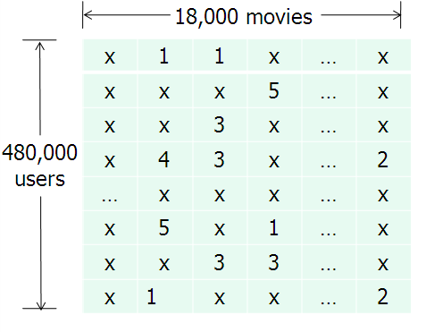
Ratings matrix
NOTE
This matrix will always be sparse!
source: http://www.eecs.berkeley.edu/~zhanghao/main/publications/subfolder/netflix.png

Slide 35
Collaborative filtering
Collaborative filtering can be done in two different ways.

Slide 36
Collaborative filtering
Collaborative filtering can be done in two different ways.
Item-based CF uses ratings data to create an item-item similarity matrix.

Slide 37
Collaborative filtering
Collaborative filtering can be done in two different ways.
Item-based CF uses ratings data to create an item-item similarity matrix.
Recommendations are then made to a user for items most similar to those that the user has already rated highly.

Slide 38
Collaborative filtering
Collaborative filtering can be done in two different ways.
Item-based CF uses ratings data to create an item-item similarity matrix.
Recommendations are then made to a user for items most similar to those that the user has already rated highly.
This is also called memory-based CF.

Slide 39
Collaborative filtering
Collaborative filtering can be done in two different ways.
Item-based CF uses ratings data to create an item-item similarity matrix.
Recommendations are then made to a user for items most similar to those that the user has already rated highly.
This is also called memory-based CF.
NOTE
This is equivalent to a clustering problem in the space of column vectors (items).
Item-based CF is a neighborhood method.
Notes:
(user-based collaborative filtering is possible but less efficient, since there are typically more users than items).

Slide 40
Collaborative filtering
Collaborative filtering can be done in two different ways.
Item-based CF uses ratings data to create an item-item similarity matrix.
Recommendations are then made to a user for items most similar to those that the user has already rated highly.
This is also called memory-based CF.
NOTE
This is equivalent to a clustering problem in the space of column vectors (items)!
Item-based CF is a neighborhood method.
NOTE
User-based collaborative filtering is possible but less efficient, since there are typically more users than items.

Slide 41
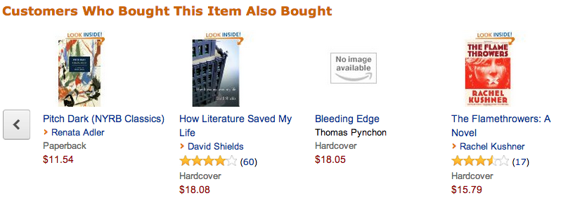
Item-based collaborative filtering
Notes:
First & most famous example of item-based CF

Slide 42
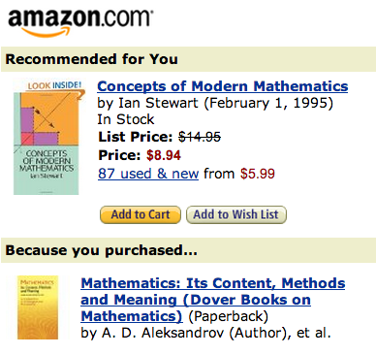
Collaborative filtering
Neighborhood methods such as item-based CF are popular and easy to understand, but they don’t scale well.

Slide 43
Collaborative filtering
Neighborhood methods such as item-based CF are popular and easy to understand, but they don’t scale well.
NOTE
Item-based CF is different than content-based filtering!
Though we’re making recommendations based on items, we are not embedding the items in a feature space.

Slide 44
Collaborative filtering
Model-based collaborative filtering abandons the neighborhood approach and applies other techniques to the ratings matrix.

Slide 45
Collaborative filtering
Model-based collaborative filtering abandons the neighborhood approach and applies other techniques to the ratings matrix.
The most popular model-based CF techniques use matrix decomposition techniques to find deeper structure in the ratings data.

Slide 46
Collaborative filtering
Model-based collaborative filtering abandons the neighborhood approach and applies other techniques to the ratings matrix.
The most popular model-based CF techniques use matrix decomposition techniques to find deeper structure in the ratings data.
For example, we could decompose the ratings matrix via SVD to reduce the dimensionality and extract latent variables.

Slide 47
Collaborative filtering
Once we identify the latent variables in the ratings matrix, we can express both users and items in terms of these latent variables.

Slide 48
Collaborative filtering
Once we identify the latent variables in the ratings matrix, we can express both users and items in terms of these latent variables.
As before, values in the item vectors represent the degree to which an item exhibits a given feature, and values in the user vectors represent user preferences for a given feature.

Slide 49
Collaborative filtering
Once we identify the latent variables in the ratings matrix, we can express both users and items in terms of these latent variables.
As before, values in the item vectors represent the degree to which an item exhibits a given feature, and values in the user vectors represent user preferences for a given feature.
Ratings are constructed by taking dot products of user & item vectors in the latent feature space.

Slide 50
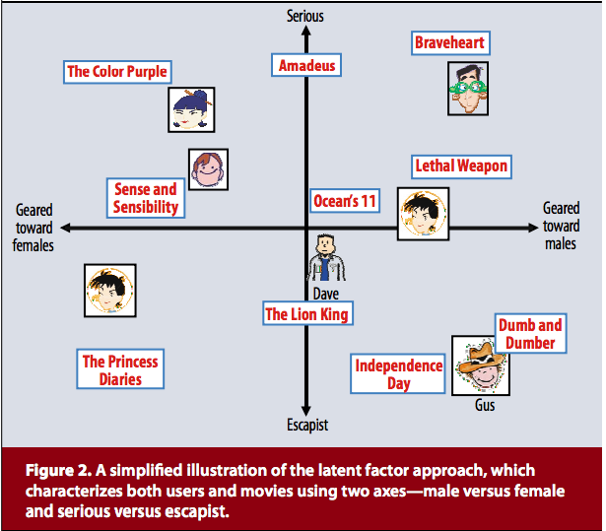
Collaborative filtering
source: http://www2.research.att.com/~volinsky/papers/ieeecomputer.pdf

Slide 51
Collaborative filtering
This approach is domain independent, and requires no explicit user or item profiles to be created.

Slide 52
Collaborative filtering
This approach is domain independent, and requires no explicit user or item profiles to be created.
It combines predictive accuracy, scalability, and enough flexibility for practical modeling (we’ll see what this means in a moment).

Slide 53
Collaborative filtering
This approach is domain independent, and requires no explicit user or item profiles to be created.
It combines predictive accuracy, scalability, and enough flexibility for practical modeling (we’ll see what this means in a moment).
Since the conclusion of the Netflix prize, these latent factor methods for collaborative filtering have been regarded as the state-of-the-art in recsys technology.

Slide 54
Collaborative filtering
But they do have some drawbacks:
- lots of (high-dimensional) ratings data needed
- data is typically very sparse (in the Netflix prize dataset, ~99% of
possible ratings were missing)
- susceptible to fraud (eg shilling attacks)
- cold start problem: need lots of data on new user or item before
recommendations can be made

Slide 55
Cold start problem
The cold start problem arises because we’ve been relying only on ratings data, or on explicit feedback from users.

Slide 56
Cold start problem
The cold start problem arises because we’ve been relying only on ratings data, or on explicit feedback from users.
Until a user rates several items, we don’t know anything about her preferences!

Slide 57
Cold start problem
The cold start problem arises because we’ve been relying only on ratings data, or on explicit feedback from users.
Until a user rates several items, we don’t know anything about her preferences!
We can get around this by enhancing our recommendations using implicit feedback, which may include things like item browsing behavior, search patterns, purchase history, etc.

Slide 58
Cold start problem
While explicit feedback (ratings, likes, purchases) leads to high quality ratings, the data is sparse and cold starts are problematic.

Slide 59
Cold start problem
While explicit feedback (ratings, likes, purchases) leads to high quality ratings, the data is sparse and cold starts are problematic.
Meanwhile implicit feedback (browsing behavior, etc) leads to less accurate ratings, but the data is much more dense (and less invasive to collect).

Slide 60
Cold start problem
While explicit feedback (ratings, likes, purchases) leads to high quality ratings, the data is sparse and cold starts are problematic.
Meanwhile implicit feedback (browsing behavior, etc) leads to less accurate ratings, but the data is much more dense (and less invasive to collect).
Implicit feedback can help to infer user preferences when explicit feedback is not available, therefore easing the cold start problem.

Slide 61
Hybrid methods
Hybrid filtering methods provide another way to get around the cold start problem by combining filtering methods (eg, by using content-based info to “boost” a collaborative model).

Slide 62
Hybrid methods
Hybrid filtering methods provide another way to get around the cold start problem by combining filtering methods (eg, by using content-based info to “boost” a collaborative model).
This content-based info can be item-based as above, or even user-based (eg, demographic info).

Slide 63
Hybrid methods
Hybrid filtering methods provide another way to get around the cold start problem by combining filtering methods (eg, by using content-based info to “boost” a collaborative model).
This content-based info can be item-based as above, or even user-based (eg, demographic info).
Hybrid methods can also make the data sparsity issue easier to deal with, by broadening the set of features under consideration.

Slide 64
IiI. A simple matrix factorization model
INTRO TO DATA SCIENCE

Slide 65
simple matrix factorization model
Matrix factorization decomposes the ratings matrix and maps users and items into a low-dimensional vector space spanned by a basis of latent factors.

Slide 66
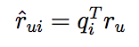
simple matrix factorization model
Matrix factorization decomposes the ratings matrix and maps users and items into a low-dimensional vector space spanned by a basis of latent factors.
Predicted ratings are given by inner products in this space, so for user u and item i we can write:

Slide 67
simple matrix factorization model
Factoring the ratings matrix via SVD leads to difficulty, since the matrix is typically sparse and therefore our information about the data is incomplete.

Slide 68
simple matrix factorization model
Factoring the ratings matrix via SVD leads to difficulty, since the matrix is typically sparse and therefore our information about the data is incomplete.
Interpolating missing values is an expensive process and can lead to inaccurate predictions, so we need another way to perform this factorization.

Slide 69
simple matrix factorization model
One possibility is to learn the feature vectors using the observed ratings only. Since this dramatically reduces the size of the ratings matrix, we have to be careful to avoid overfitting.

Slide 70
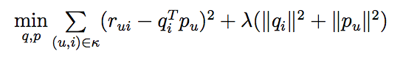
simple matrix factorization model
One possibility is to learn the feature vectors using the observed ratings only. Since this dramatically reduces the size of the ratings matrix, we have to be careful to avoid overfitting.
We can learn these feature vectors by minimizing the loss function:
where κ denotes the set of known ratings, and λ is a hyperparameter.

Slide 71
simple matrix factorization model
One possibility is to learn the feature vectors using the observed ratings only. Since this dramatically reduces the size of the ratings matrix, we have to be careful to avoid overfitting.
We can learn these feature vectors by minimizing the loss function:
where κ denotes the set of known ratings, and λ is a hyperparameter.
NOTE
The loss function has two unknowns (q, p) and so is not convex!
This can be minimized using a method called alternating least squares.

Slide 72
simple matrix factorization model
It turns out that much of the variation in observed ratings is due to user or item biases (eg, some users are very critical, or some items are universally popular).

Slide 73
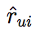
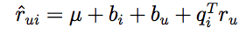
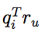
simple matrix factorization model
It turns out that much of the variation in observed ratings is due to user or item biases (eg, some users are very critical, or some items are universally popular).
We can capture these biases in our model by generalizing :
Here μ is a global average rating, b_{i} is the item bias, b_{u} is the user bias, and is the user-item interaction.

Slide 74
simple matrix factorization model
With this generalization, our minimization problem becomes:

Slide 75
simple matrix factorization model
With this generalization, our minimization problem becomes:
Further modifications can be made to this model (incorporating implicit feedback, capturing temporal effects, attaching confidence scores to predictions), and you can look up the details in the references.

Slide 76
Iv. The netflix prize
INTRO TO DATA SCIENCE

Slide 77
The netflix prize
The Netflix prize was a competition to see if anyone could make a 10% improvement to Netflix’s recommendation system (accuracy measured by RMSE).

Slide 78
The netflix prize
The Netflix prize was a competition to see if anyone could make a 10% improvement to Netflix’s recommendation system (accuracy measured by RMSE).
The grand prize was $1mm dollars, with annual $50k progress prizes to the leader at the end of each year if the 10% threshold had not yet been met. Approx 50k teams participated from >180 countries.

Slide 79
The netflix prize
The Netflix prize was a competition to see if anyone could make a 10% improvement to Netflix’s recommendation system (accuracy measured by RMSE).
The grand prize was $1mm dollars, with annual $50k progress prizes to the leader at the end of each year if the 10% threshold had not yet been met. Approx 50k teams participated from >180 countries.
The ratings matrix contained >100mm numerical entries (1-5 stars) from ~500k users across ~17k movies. The data was split into train/quiz/test sets to prevent overfitting on the test data by answer submission (this was a clever idea!)

Slide 80
The netflix prize
The competition began in 2006, and the grand prize was eventually awarded in 2009. The winning entry was a stacked ensemble of 100’s of models (including neighborhood & matrix factorization models) that were blended using boosted decision trees.

Slide 81
The netflix prize
The competition began in 2006, and the grand prize was eventually awarded in 2009. The winning entry was a stacked ensemble of 100’s of models (including neighborhood & matrix factorization models) that were blended using boosted decision trees.
Ultimately, the competition ended in a photo finish. The winning strategy came down to last-minute team mergers & creative blending schemes to shave 3rd & 4th decimals off RMSE (concerns that would not be important in practice).

Slide 82
The netflix prize
The competition began in 2006, and the grand prize was eventually awarded in 2009. The winning entry was a stacked ensemble of 100’s of models (including neighborhood & matrix factorization models) that were blended using boosted decision trees.
Ultimately, the competition ended in a photo finish. The winning strategy came down to last-minute team mergers & creative blending schemes to shave 3rd & 4th decimals off RMSE (concerns that would not be important in practice).
The competition did much to spur interest and research advances in recsys technology, and the prize money was donated to charity.
Notes:
http://www.techdirt.com/blog/innovation/articles/20120409/03412518422/why-netflix-never-implemented-algorithm-that-won-netflix-1-million-challenge.shtml

Slide 83
epilogue
Though they adopted some of the modeling techniques that emerged from the competition, Netflix never actually implemented the prizewinning solution.
Why do you think that’s true?
Notes:
http://techblog.netflix.com/2012/04/netflix-recommendations-beyond-5-stars.html

